Slide 1
Holistic Web Application
Professor: Dr. Robert Gilliland
Team Members: Thanuj Reddy Chamakura
Sai Lokesh Vunnam
Venkatesh Siddabathula

Slide 2
Introduction
In today's fast-paced world, keeping track of tasks, expenses, and important files can be a real headache. Imagine having everything you need to manage your life in one handy app. That's exactly what we're proposing—a simple, user-friendly web application that combines task lists, expense tracking, and file storage into a single, easy-to-use platform.
With our solution, you won't need to jump between different apps anymore. Instead, you'll have everything you need right at your fingertips. Whether it's organizing your to-dos, keeping tabs on your spending, or securely storing important documents, our app has got you covered. Say goodbye to stress and hello to a more organized and productive life!

Slide 3
Project Background
In today's modern world, the abundance of digital tools has brought convenience but also complexity to our daily routines. The need to manage tasks, track expenses, and store documents efficiently has become increasingly challenging amidst the plethora of disparate applications. Recognizing this, our project proposes a solution: a unified web application that merges task management, expense tracking, and file storage into one intuitive platform. Our motivation stems from a desire to simplify the chaotic landscape of digital organization, offering users a seamless experience that enhances productivity and reduces stress.

Slide 4
Problem Statement
In today's world, it's tough to keep everything organized. People use different apps for tasks, money tracking, and storing files, which can be confusing and time-consuming. Switching between apps makes things even more complicated and can make people feel stressed out and less productive. We need a simple solution that combines all these features into one easy-to-use app. This way, people can manage their tasks, track their money, and store their files all in one place, making their lives simpler and helping them stay organized.

Slide 5
Methodology
Our approach to building the web application starts with careful planning and understanding what our users need. We talk to people, ask questions, and do research to figure out how to make the app helpful for them. We're using Angular for making the app look nice and Spring Boot for making sure everything works smoothly behind the scenes. We also use MySQL and phpMyAdmin to organize all the information people put into the app.
Once we have a good plan, we start building the app. We make sure the app looks good and works well on the outside with Angular, while Spring Boot helps us handle everything inside. With MySQL and phpMyAdmin, we keep all the information safe and organized. After testing and getting feedback from users, we make any necessary changes to improve the app.

Slide 6



Technology
Front end- Angular
Back end- Spring Boot
Database- Mysql(Php myadmin)

Slide 7
Experiments
Enhancing App Features Based on User Feedback
Gathering feedback from both the poster presentation and classmates who have used the app provides valuable insights into areas for improvement. By organizing and analyzing this feedback, common themes and recurring issues can be identified, forming the basis for prioritizing enhancements. Through this process, critical feedback points with the greatest impact on user experience are determined and targeted for improvement, ensuring that resources are allocated effectively.
Taking an iterative design approach allows for focused improvements to be made to specific features of the app. By implementing changes incrementally and testing them with a smaller group of users, the effectiveness of these enhancements can be assessed more efficiently. This approach also facilitates validation of improvements through additional feedback gathering, enabling iterative refinement until the desired user experience is achieved.

Slide 8
Experiments
Throughout the improvement process, maintaining a user-centric focus is paramount. By keeping user needs and preferences at the forefront of the design process, proposed enhancements are aligned with the overarching goals of the app. This ensures that improvements not only address identified issues but also contribute to enhancing the overall user experience, resulting in a more effective and user-friendly solution.

Slide 9
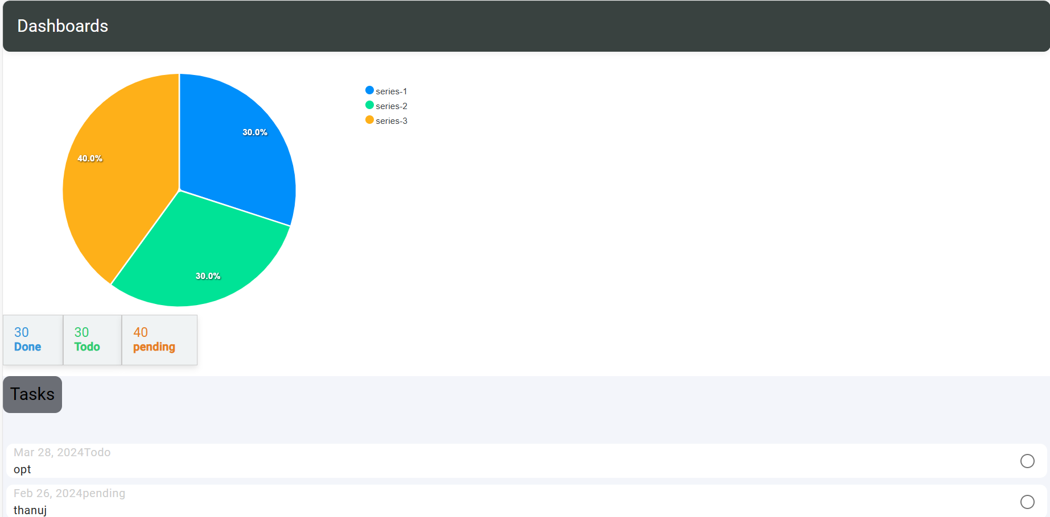

Slide 10
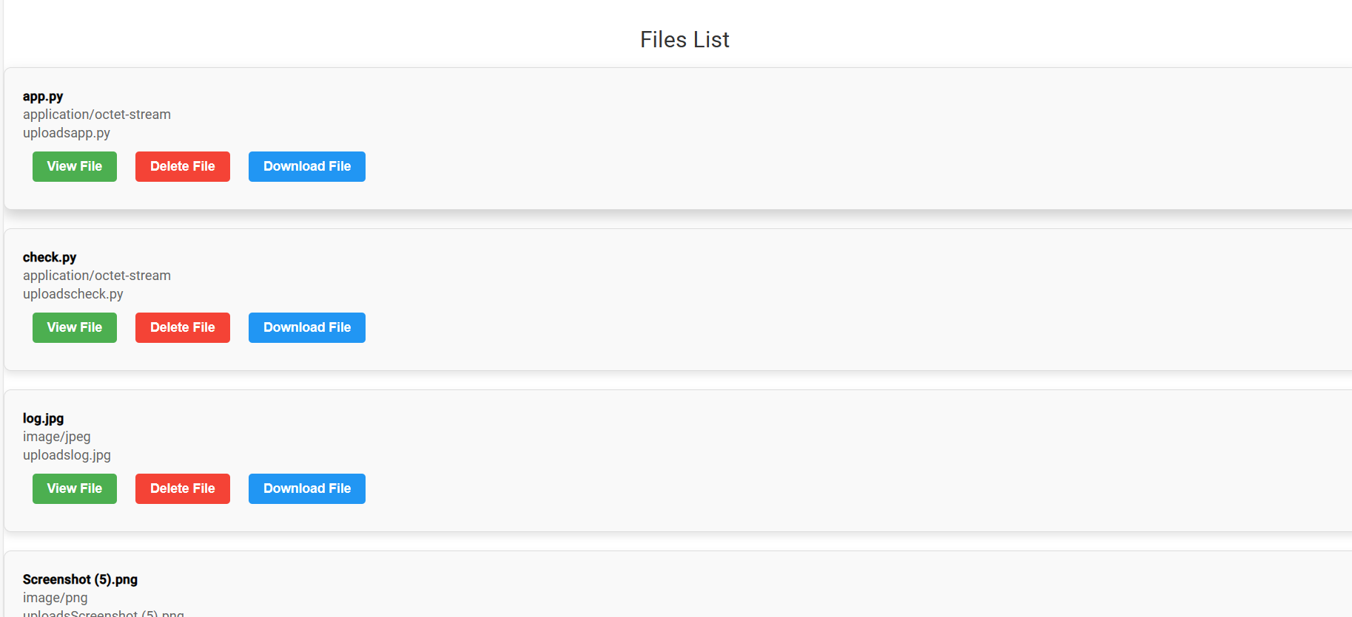

Slide 11
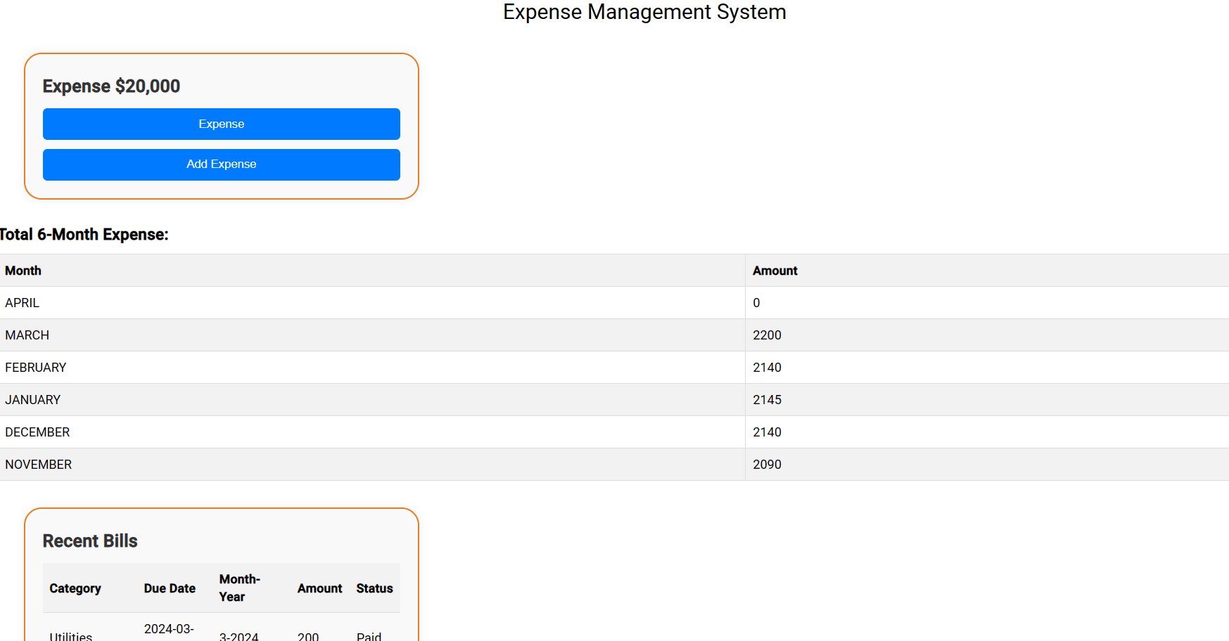

Slide 12
Discussion
In today's dynamic environment, the need for streamlined organization solutions is more apparent than ever. Our project aims to address this challenge by proposing a comprehensive web application that integrates task management, expense tracking, and file storage into a unified platform. Through collaborative discussions with our team members, professor, and fellow students, we've refined our ideas to ensure that our solution meets the diverse needs of users. By consolidating essential functionalities into a user-friendly interface, our app promises to simplify users' lives, eliminating the hassle of switching between multiple tools. From prioritizing tasks to monitoring expenses and securely storing documents, our app offers a one-stop solution for enhancing productivity and organization.

Slide 13
Conclusion
Our project set out to make life easier in the digital age by creating a single app to handle tasks, expenses, and files. By listening to feedback from our presentations and testing sessions, we've made improvements that make the app more user-friendly. As we keep working on it, we'll make sure to keep listening to users and finding ways to make the app even better. Our goal is to help people take charge of their lives more easily in today's busy world.

Slide 14
Team member Contribution
Venkatesh: Venkatesh spearheaded the frontend development using Angular. His dedication to creating an intuitive user interface resulted in a visually appealing and user-friendly experience for app users.

Slide 15
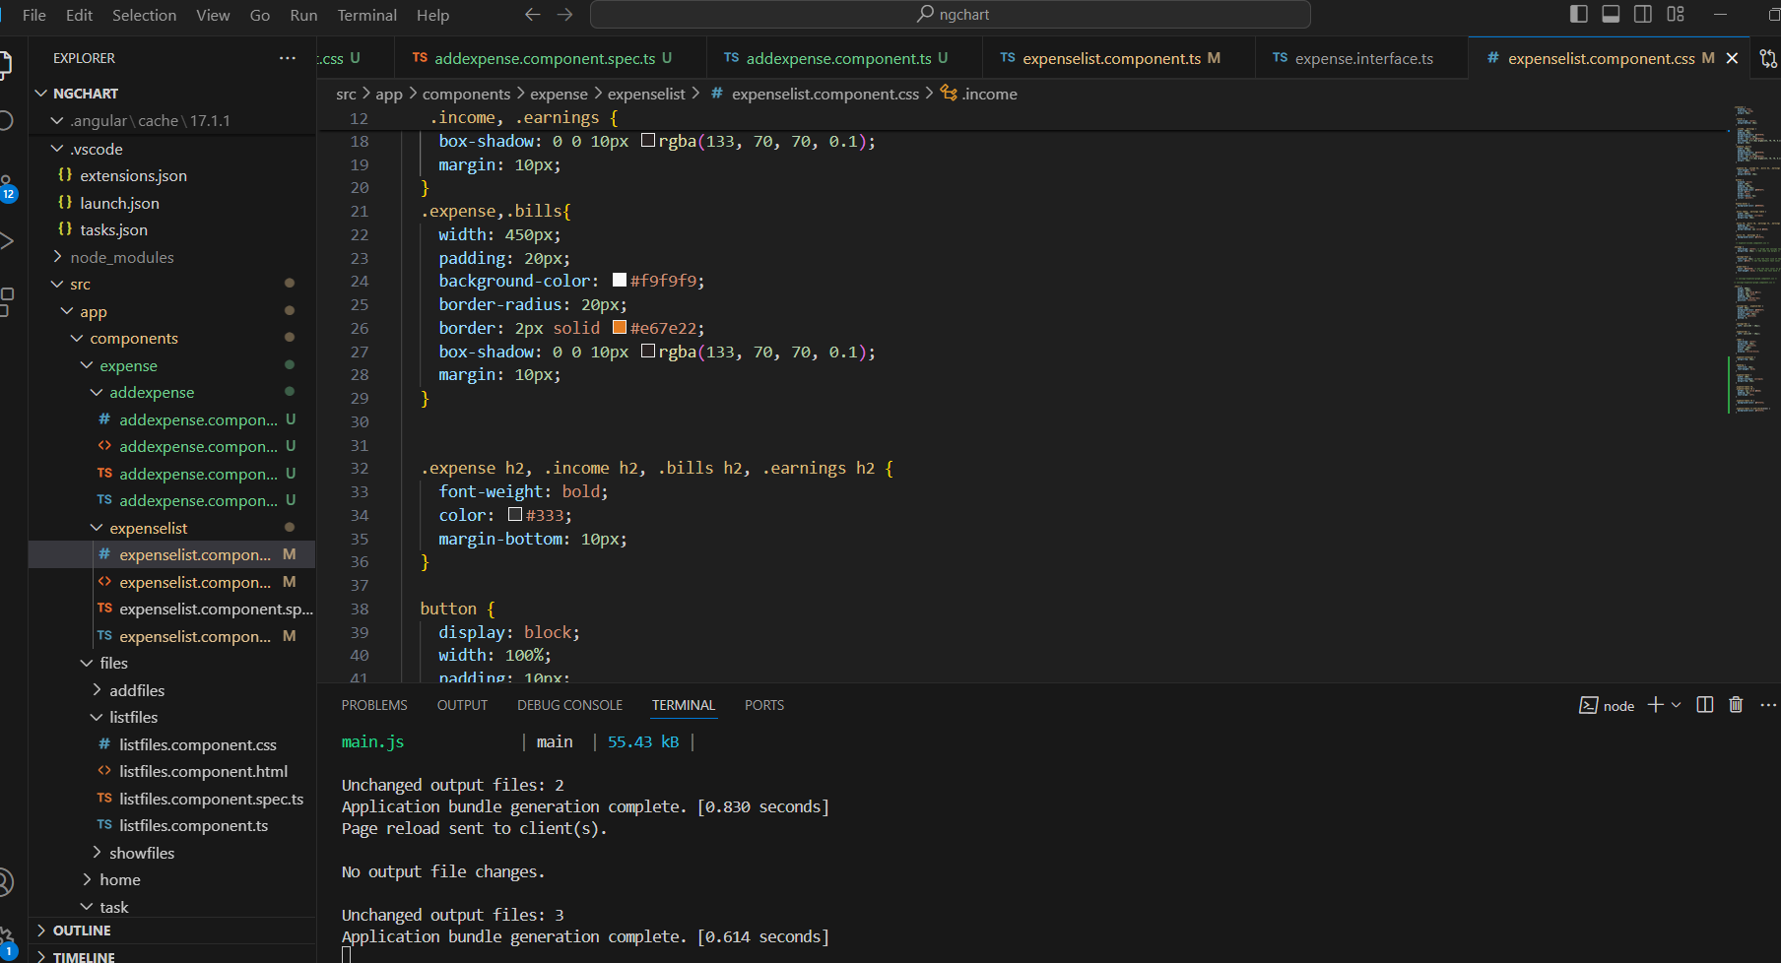

Slide 16
Sai Lokesh Vunnam
Sai Lokesh managed the database effectively, utilizing his skills in database management to ensure the secure storage and efficient retrieval of user data. His contribution ensured the reliability and integrity of the application's data management system.

Slide 17
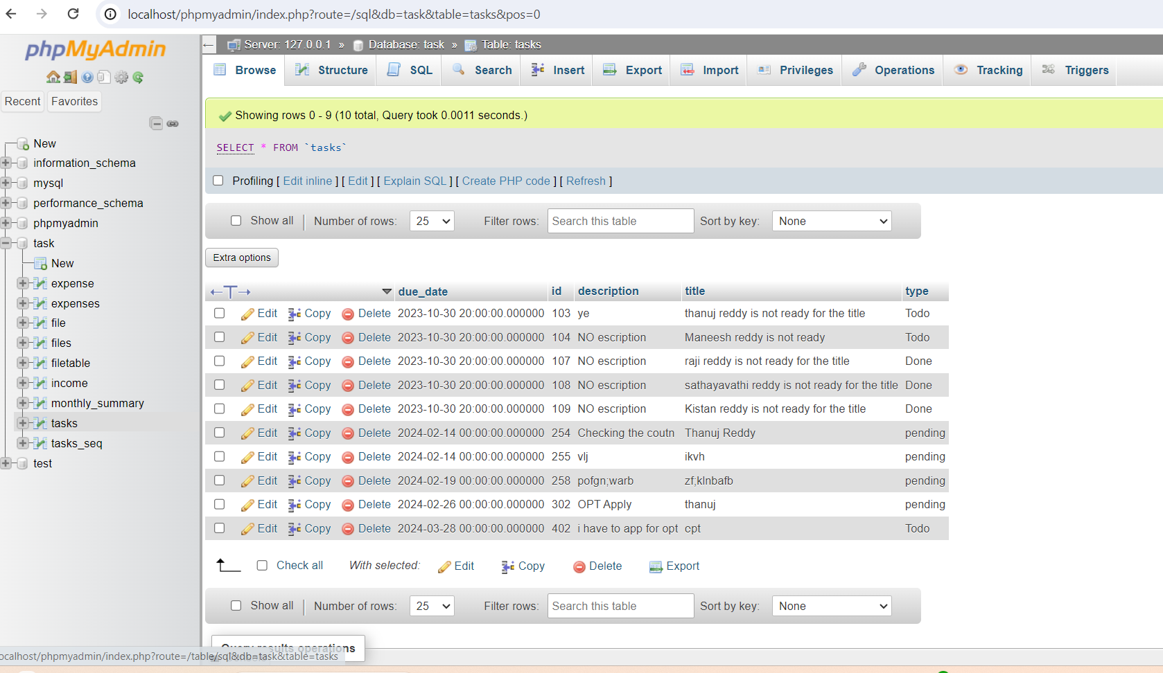

Slide 18
Thanuj Reddy Chamakura
Thanuj Reddy: Thanuj led the backend development using Spring Boot and API integration. His expertise ensured that the backend functionalities were robust and efficiently handled data processing for the application.

Slide 19
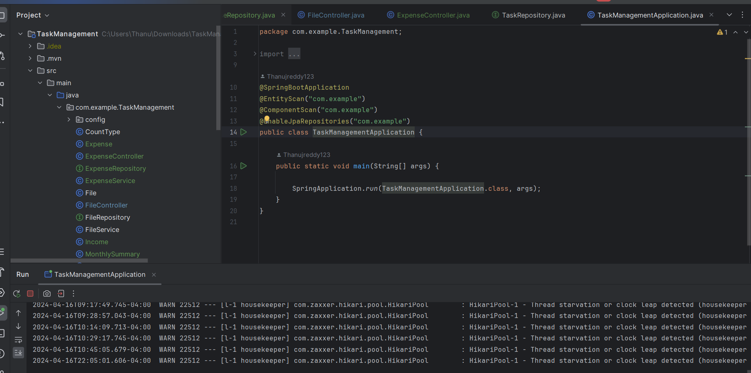

Slide 20
Thank you

